Slide 1

Programming for engineers II
Master in Sustainable Production Creation
Gustavo Martín Larrea Gallegos [ gustavo.larrea@list.lu ]
University of Luxembourg
Master in Sustainable Product Creation
February 25th , 2025

Slide 2
Summary
>> The history of computer science is the history of problem solving
>> Digital systems process discrete information using binary values
>>> numbers, strings, or code are expressed as bytes
>>> In modern computers, instructions are also stored as data.
>> We can operate a machine thanks to the operating system
>>> We can use GUI or CLIs
>>> Programs are files in executable formats
>>> There are different types of programming languages.

Slide 3
What is python?

Slide 4
Python
“Python is an interpreted, object-oriented, high-level programming language with dynamic semantics. Its high-level built in data structures, combined with dynamic typing and dynamic binding, make it very attractive for Rapid Application Development, as well as for use as a scripting or glue language to connect existing components together. Python's simple, easy to learn syntax emphasizes readability and therefore reduces the cost of program maintenance. [...] “
[source]

Slide 5
Python
“Python is an interpreted, object-oriented, high-level programming language with dynamic semantics. Its high-level built in data structures, combined with dynamic typing and dynamic binding, make it very attractive for Rapid Application Development, as well as for use as a scripting or glue language to connect existing components together. Python's simple, easy to learn syntax emphasizes readability and therefore reduces the cost of program maintenance. [...] “
[source]

Slide 6
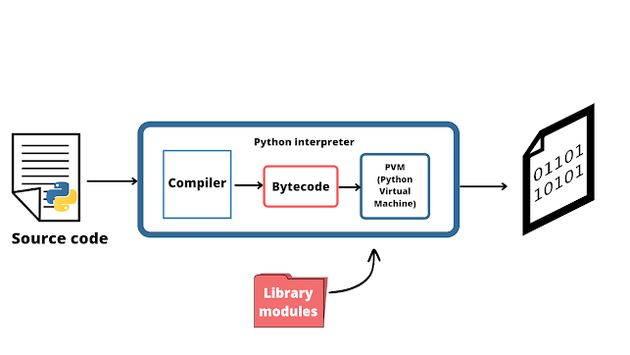
Interpreted language
Interpreters take code and convert it to machine code
[source]

Slide 7
Object Oriented language
Python is object-oriented, but it also allows other paradigms.
In Python, everything is an object
Objects are instances of classes that contain data and behavior
Code is reusable and modular (Each object is self-contained)

Slide 8


High-level language
Python has multiple abstractions
Easy to read and maintain
Has simpler abstractions compared to other programming languages
test.c
test.py
/* Simple C program (test.c) */
#include <stdio.h>
int main() {
int year = 2024;
printf("Hello World!\n");
printf("Luxembourg changed a lot in %d.\n", year);
return 0;
}
year = 2024
print("Hello World!")
print(f"Luxembourg changed a lot in {year}")

Slide 9
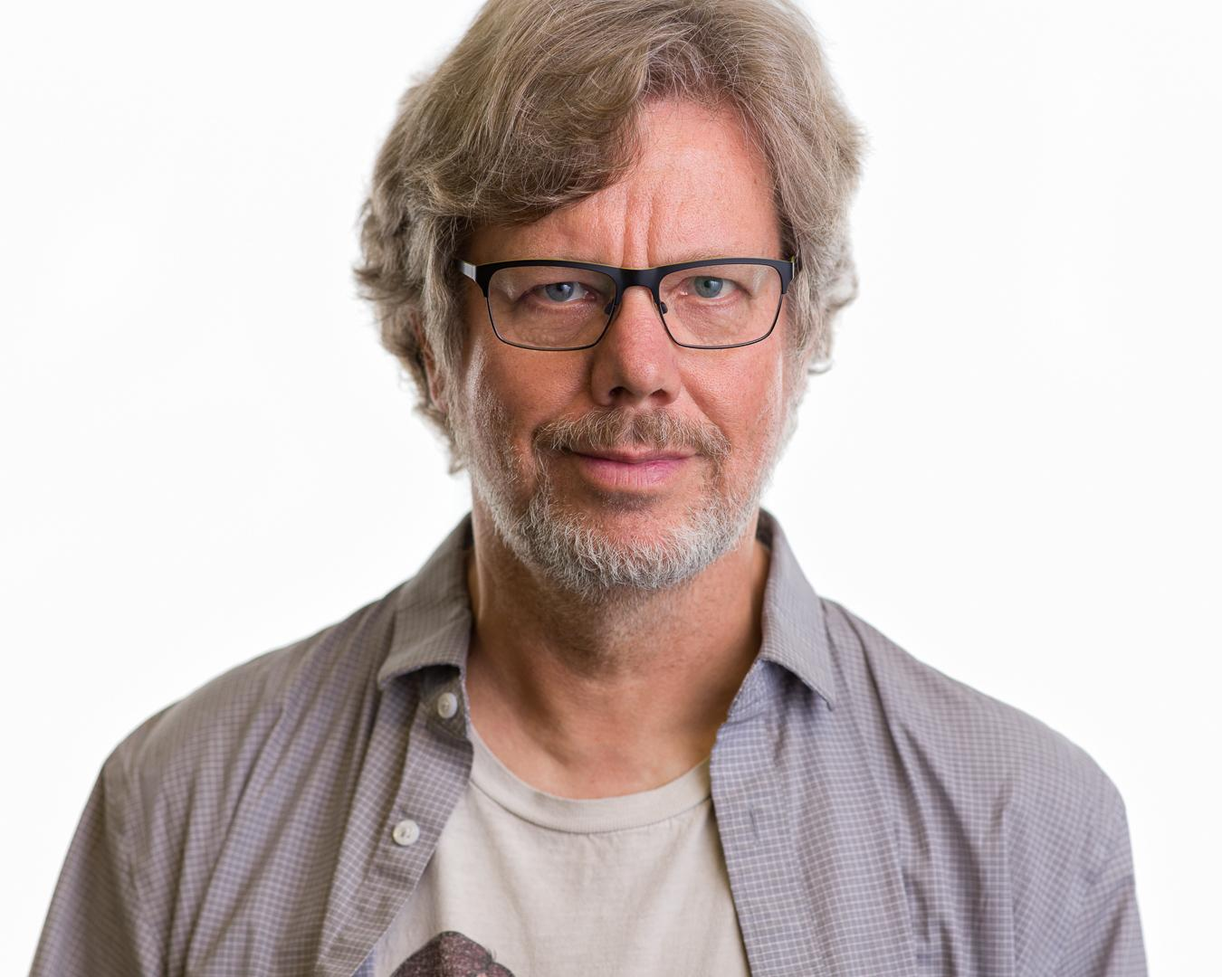
History of python
Released in 1991 by Guido van Rossum (successor of the ABC language).
[source]

Slide 10
History of python
Released in 1991 by Guido van Rossum (successor of the ABC language).
Open-source project, run by the benevolent dictator for life (BDFL)

Slide 11
History of python
Released in 1991 by Guido van Rossum (successor of the ABC language).
Open-source project, run by the benevolent dictator for life (BDFL)
Currently at version 3.13
Backward incompatibility between versions 2 and 3.

Slide 12
History of python
Released in 1991 by Guido van Rossum (successor of the ABC language).
Open-source project, run by the benevolent dictator for life (BDFL)
Currently at version 3.13
Backward incompatibility between versions 2 and 3.
Currently, It is one of the most used programming in the world.
Most AI/ML research is done in python

Slide 13
History of python
Released in 1991 by Guido van Rossum (successor of the ABC language).
Open-source project, run by the benevolent dictator for life (BDFL)
Currently at version 3.13
Backward incompatibility between versions 2 and 3.
Currently, It is one of the most used programming in the world.
Most AI/ML research is done in python
[cool video here]

Slide 14
Lets install Ananconda/miniconda, all OS [here]

Slide 15
Setup your environment
$ conda create -n my_environment python=3.13
$ conda activate my_environment
$ pip install jupyterlab

Slide 16
Elements of python programming

